Slide 1
AMERICAN REVOLUTION
INTERESTING FACTS

Slide 2

The American Revolution period is full of surprising
and sometimes funny facts.

Slide 3
What Was the Boston Tea Party?
The Boston Tea Party was an important protest that happened on December 16, 1773, in Boston Harbor.
American colonists were angry because Britain was taxing them but they had no representatives in the British government.
This idea became known as “taxation without representation.”
To protest these taxes, a group of colonists boarded British ships and threw 342 chests of tea into the harbor.
This event became one of the actions that helped lead to the American Revolution.

Slide 4
Why Were the Colonists Angry?
For many years, Britain had been passing laws that placed taxes on the American colonies.T
wo important laws made people especially upset:
The Townshend Acts – taxes on everyday goods
The Tea Act – gave the British East India Company the right to sell tea directly in the colonies
This law hurt colonial merchants and showed that Britain believed it had the right to control the colonies.
Many colonists believed this was unfair.

Slide 5
Who were the merchants?
The merchants were American colonial business owners who bought goods from
Britain and then sold them in the colonies. They were not British officials. They lived in
cities like Boston, New York, and Philadelphia. So they were colonists, just like other people living in the American colonies.
What changed with the Tea Act?
Before the Tea Act:
-The British East India Company shipped tea to Britain.
-British merchants sold it to colonial merchants.
-Colonial merchants sold it to people in the colonies.
So colonial merchants earned money by selling the tea.

Slide 6
After the Tea Act
The Tea Act allowed the East India Company to ship tea directly to the colonies and sell it themselves.
This meant:
X Colonial merchants were cut out of the business
X They lost their profits
X Britain gained more control over trade
Why this made people angry
Many colonists believed Britain was:
hurting colonial businesses
-forcing them to accept taxes
-increasing British control
This anger helped lead to the Boston Tea Party in 1773.

Slide 7
BOSTON TEA PARTY
Key facts
Date: December 16, 1773
Location: Griffin’s Wharf, Boston, Massachusetts
Participants: About 60–150 colonists, many disguised as Mohawk Indians
Ships involved: Dartmouth, Eleanor, Beaver
Tea destroyed: 342 chests (~92,000 lbs; ≈$1.7 million today)

Slide 8
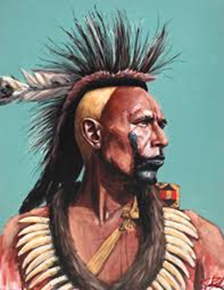
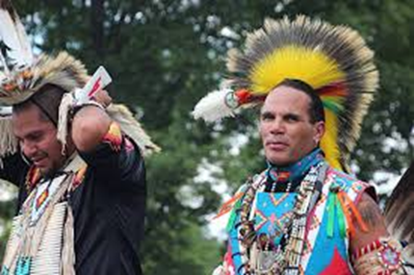
The Night of the Protest
On the evening of December 16, many people in Boston gathered at the Old South Meeting House to discuss what to do.
When Thomas Hutchinson, the governor of Massachusetts, refused to send the tea ships back to England, the protest began.
A group called the Sons of Liberty, led by Samuel Adams, went to the ships at Griffin’s Wharf. Some of them dressed up to look like Native Americans so they would not be recognized.

Slide 9
The Night of the Protest (cont.)
For about three hours, they broke open tea chests and dumped the tea into the cold water of Boston Harbor.
Interestingly, they were very careful not to steal anything or damage the ships.
Their goal was only to destroy the tea.
Why Is This Event Important?
The Boston Tea Party was a strong protest against British rule.
Britain responded by punishing the colonies with strict laws called the Intolerable Acts.
These events increased the conflict between Britain and the colonies and helped lead to the American Revolution.

Slide 10
The Main Intolerable (extreme) Acts
Boston Port Act
Britain closed the port of Boston.No ships could enter or leave the harbor.Trade stopped.The port would stay closed until the colonists paid for the destroyed tea.This hurt many workers and merchants in Boston.
2. Massachusetts Government Act
Britain took away much of Massachusetts’ self-government. The king could appoint many officials. Town meetings were limited. Colonists felt they were losing their political rights.
3. Administration of Justice Act
British officials accused of crimes in the colonies could be sent to Britain or another colony for trial. Many colonists believed this meant those officials could escape punishment.

Slide 11
The Main Intolerable Acts (cont.)
4.Quartering Act
Colonists had to provide housing for British soldiers if necessary. This made people angry because soldiers could be placed in towns and buildings without permission.
Why These Laws Were Important
Instead of calming the situation, the Intolerable Acts made colonists even more united against Britain.
Many colonies began working together, which eventually led to the American Revolutionary War.

Slide 12
Please Answer the Following Questions:
Why were many colonists angry about the tea tax even though the tea was sometimes cheaper?
2. What happened during the Boston Tea Party?
3. Why did some protesters wear disguises during the protest in Boston Harbor?
4. What drink did some colonists start using instead of tea after the protest?
5. Imagine you lived in 1775. What would be the hardest modern invention or technology for you to live without? Explain why.

Slide 13
Answer Key
Colonists were angry because they believed Britain did not have the right to tax them since they had no representatives in the British government (“taxation without representation”).
2. Colonists boarded ships in Boston Harbor and threw 342 chests of tea into the water to protest British taxes.
3. Protesters wore disguises so they would not be recognized or punished by British authorities.
4. Many colonists began drinking “Liberty Tea,” a drink made from local herbs and plants instead of British tea.
5. Possible answers include electricity, phones, computers, hot water, or modern medicine.

